Slide 1
Comprehensive Fiscal Analysis
Mountain House Incorporation
San Joaquin LAFCO Study Session
Thursday, July 13, 2023

Slide 2
Purpose and Background
County adopted the Master Plan for the area in 1993
In 1996, Board of Supervisors created the MHCSD
Community now has over 27,000 residents
  May grow to 45,000 or more in 10 years
Incorporation has been expected for years

Slide 3
What is a Comprehensive Fiscal Analysis?
Impartial financial analysis of the proposed City to inform the public and LAFCO
A realistic picture of how the new city will operate
CFA becomes a part of the Executive Officer’s Report and is submitted to the Commission

Slide 4
Components of the CFA
Background
Plan for Services and City Staffing Levels
  Incorporation Proposal
  Comparison cities
Growth and Development
  Population growth
  Development
Estimate of Revenues & Expenditures

Slide 5
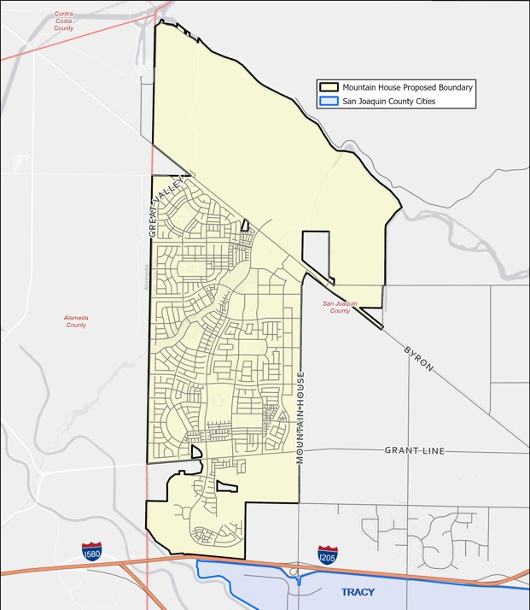
Incorporation Application Summary
Incorporation of new City
  Reorganization of CSD
File Date: February 2021
Effective Date: July 1, 2024
Coterminous with CSD area
Affected Agencies
  County of San Joaquin
  Mountain House CSD
  Tracy Rural Fire Protection District

Slide 6
About Mountain House CSD
Services Provided
Revenue Sources ($30m in 2021-22)
Road maintenance
Parks and recreation
Supplemental law enforcement
Fire protection
Community development (w/ Co.)
CC&R enforcement
Utilities (Domestic water and Gas)
Library services
Property taxes (15.95% of general levy)
Four Special Tax levies (no sunset)
Franchise fees
Licenses and permits
Intergovernmental
Developer Impact Fees
Investment earnings
Other revenues

Slide 7
Plan for Services Summary
Services | Post Incorporation |  | Service | Post Incorporation
General Govt | New City |  | Solid Waste | New City
Police/Traffic | New City (Contract) |  | Code Enf. | New City
Animal Control | New City (Contract) |  | Engineering | New City
Fire | New City (Contract) |  | Road Maint | New City
Planning/B&S | New City |  | Library | New City w Unif. Lib. System
Parks & Rec | New City |  | CC&R Enforce. | MHCSD Subsidiary District
Notes:
See page 16 of the CFA for details

Slide 8
Overall Findings
Incorporation is fiscally feasible
  Revenues exceed projections
  Existing fund balances carryover
Special Tax Fund is 48% total revenue, making incorporation feasible
At lower development growth, incorporation remains feasible
No revenue neutrality mitigation expected

Slide 9
General Fund Forecast

Slide 10
Special Tax Fund Forecast

Slide 11
Subsidiary District Fund

Slide 12
LLMD Funds

Slide 13
Road Fund
Notes:
The Road Fund is allowed to receive 3 years of formula funding from their Countywide sales tax measure (K I think?). But only 3 years. The gap that develops after is then covered by special taxes.

Slide 14
Affordable Housing Fund

Slide 15
Analysis of Affected Agencies
 | County of San Joaquin | Mountain House CSD | Tracy Rural FPD
Transition Period Services | Maintain existing services | Maintain existing services | Maintain existing services
Post Incorporation Services | Municipal services transferred to City | Retains CC&R Enforcement | None
Fiscal Impact | Favorable to County | Neutral | Revenue Loss of $
Revenue Neutrality | Not Applicable, No Negative Impact | Not Applicable | None, offset by CSD Improvement Agreement

Slide 16
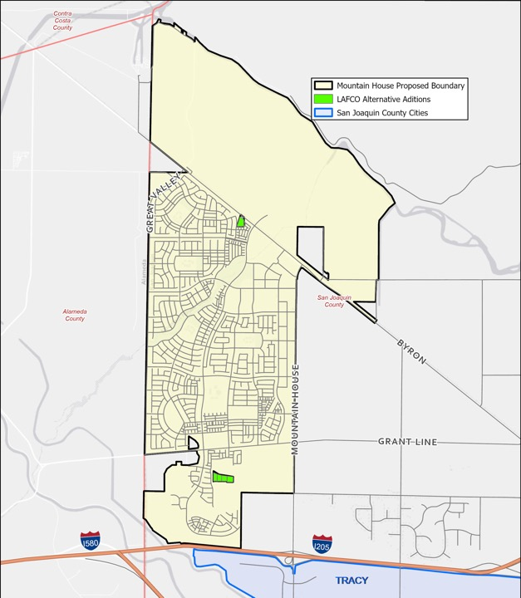
General Fund / Alternatives Analyzed
 |  |  | Net General Fund Year 1 | Net General Fund Year 9
Proposed Boundary |  |  | $1,772,197 | $6,906
 | Low Growth Scenario |  | $2,471,975 | $560,585
LAFCO Staff Boundary |  |  | $1,783,029 | $22,896
 | Low Growth Scenario |  | $2,476,936 | $580,227
Notes:
The LAFCO Executive Officer requested the consultant to analyze a larger boundary area that removes what would otherwise be unincorporated islands if incorporation were approved. This additional area amounted to a small increase in the incorporation area by including 5 parcels and approximately 10 acres outside the CSD’s boundaries. Overall, the fiscal analysis concluded this would not have a significant effect on feasibility.
Net revenues are larger surprisingly for the lower growth scenarios because more of our expenditures are tied to growth than our revenues (e.g. Property Taxes, CD fees vs. all major expenditure categories). This is where the Special Taxes helps a lot. When growth slows the service cost increase also slows which creates a larger surplus.

Slide 17
Key Terms and Conditions to be Considered
Upon incorporation, the City shall assume responsibility for all functions and services currently provided provide by the MHCSD, excepting enforcement of the Declaration of Covenants, Conditions and Restrictions.
The County shall continue to furnish all services provided to the area prior to incorporation. The new City shall reimburse San Joaquin County for the net cost of services.
The County Auditor Controller shall remit 14.94 percent of the basic tax levy to the new City’s General Fund for general municipal services.
The County Auditor Controller shall remit 1.01 percent of the basic tax levy to the newly formed Subsidiary District in order to fully fund the enforcement of the Declaration of Covenants, Conditions and Restrictions.
In the event that the timely transfer of property and sales tax revenues from the County to the City does not occur upon incorporation, these funds shall be applied towards reimbursement of County transition year services.

Slide 18
Next Steps in Application Process
Public Workshop
August
Commission Hearing
September
Election
March 2024

Slide 19
Questions and Comments
Comprehensive Fiscal Analysis - Mountain House Incorporation

